Slide 1
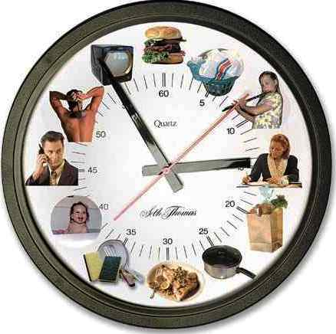
Self management for success at third- level
Adapted from Study Guides and Strategies
http://www.studygs.net/timman.htm

Slide 2
Overview
Emotional intelligence
Self-motivation & goal setting
Study skills
Managing time
Managing your thinking
Pitfalls to avoid
Support

Slide 3
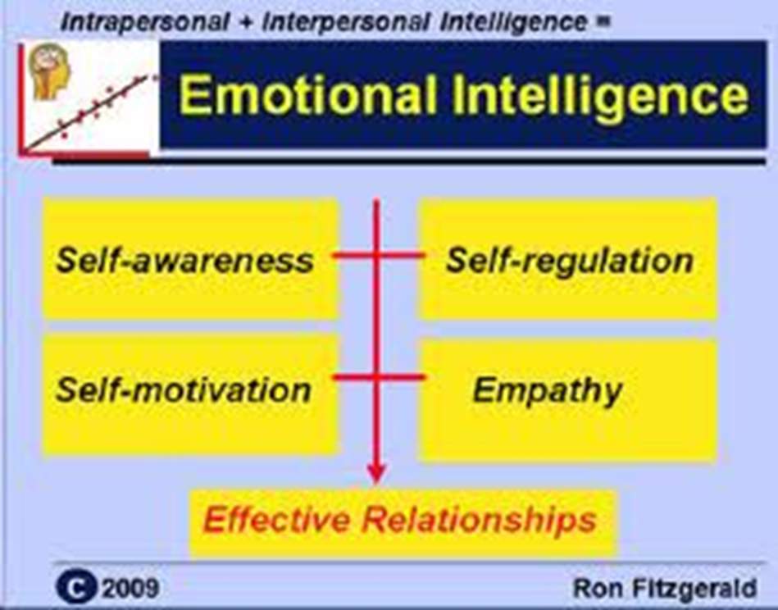

Emotional intelligence
Daniel Goleman
(1996)
5 domains

Slide 4
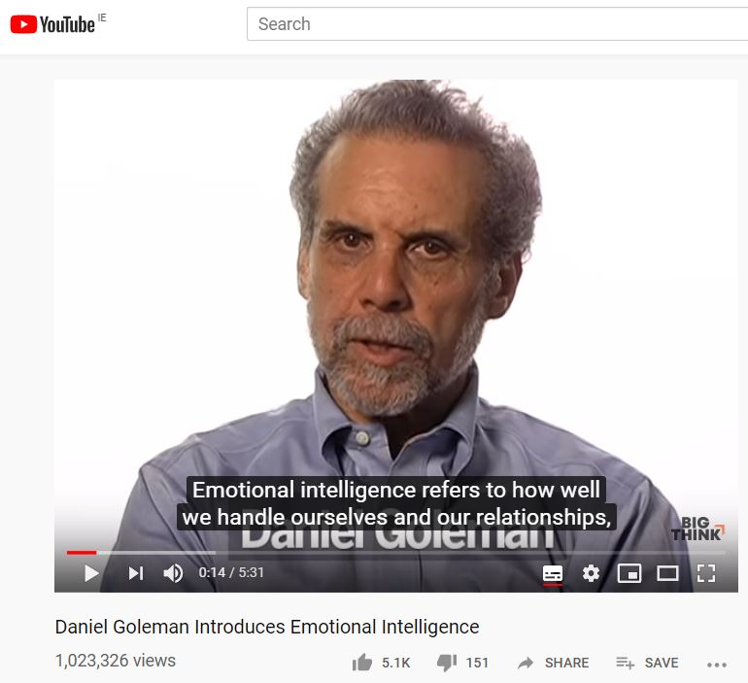
Activity
Watch the video and answer the questions on the next slide.
BigThink (2012) Daniel Goleman introduces Emotional Intelligence. Available at: https://www.youtube.com/watch?v=Y7m9eNoB3NU

Slide 5
Video - Qs
How has Goleman revised his 5 domains since 1995? [00:00-01:10]
What is the link between emotional intelligence and academic success? [01:10-02:05]
Which domains of emotional intelligence can be considered intrapersonal and which are interpersonal?
Intrapersonal - “self” (1-3)
Self-awareness
Self-regulation*
Self-motivation*
Empathy
Relationships
* self management (2012)

Slide 6


Self-motivation
Why are you in college?
Who is the main beneficiary?
Who else will benefit?
Are these benefits enough for me?

Slide 7
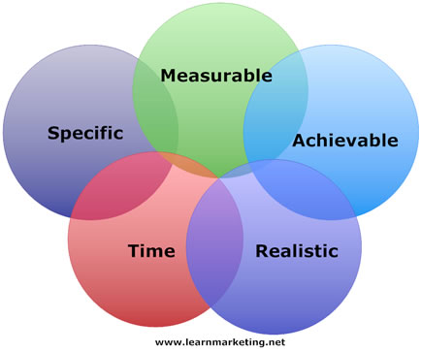
SMART goals
Goals need to be put into ACTION
Brendan wants
to learn how to drive and get his license by May 2020.
Break this goal down into short- and medium term SMART goals.

Slide 8

Focus
Keep the end goal in sight
Remember that all your work in college and study is bringing you closer to your goal
Question yourself and alignment of your actions
How does this bring me nearer my end goal?

Slide 9

Where do you study best?
Suitable furniture, light, temperature
Equipment – laptop? Internet? Pen and paper?
Free from distraction
Phone on silent
Out of sight
Turn notifications off
Breaks
Eat or drink something
Relax
Check phone
Try a change of venue occasionally

Slide 10

Pitfalls with study
Students think study is just reading
…BUT also
review & highlight notes
rewrite notes
Make mind maps,
test yourself
study groups
write your thoughts
Students do the easy subject first
Students think the academic year / semester is long

Slide 11

Pitfalls with assignments
Students don’t build in “reaction time” built in for questions and feedback on assignments before they are due

Slide 12

Managing time
When do you study best?
How long can you study for at a time?
What do you do on your study breaks?
Are you good at controlling the activity and returning to your studies?

Slide 13
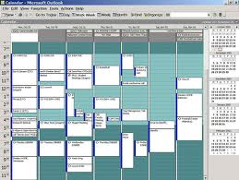
Managing time
Calendars and schedules
Big picture – semester, weeks
Short term - weekly planner with tasks for the week
Up close – night before, prep for day ahead
Review regularly and update them (assignments, tests and notes)

Slide 14
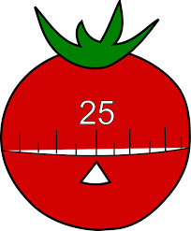
Managing time
Audit your time – where does it all go?
Small chunks, 20-25 minutes
Pomodoro technique
Use the gaps in timetables
Match work and time of day (ie. hard work when fresh)
Build work into different activities? ie. commuting

Slide 15
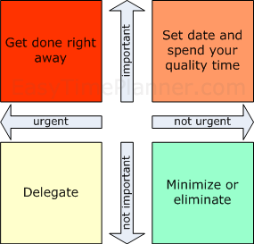
What’s the most important thing you have to do?

Slide 16

Managing your thinking
Study is a “good” problem
Minimise “work”.
I’ll just do an hour… I can watch TV later
End of study session, make a mental note of what you’ve achieved ⇒ congratulate yourself
Avoid guilt - unproductive
When not working, enjoy your time off

Slide 17

Support
Where can you get help?...
Research Have you done a good Internet search?
Classmates study groups, other positive people
AIT Tutorial support - check
Academic Writing centre
Counselling service

Slide 18



